Slide 1
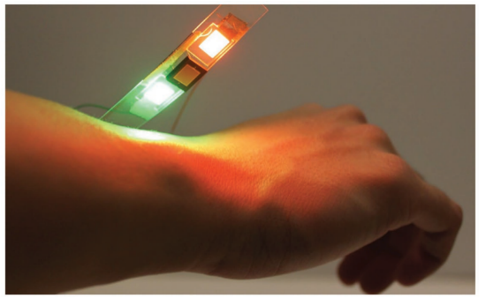
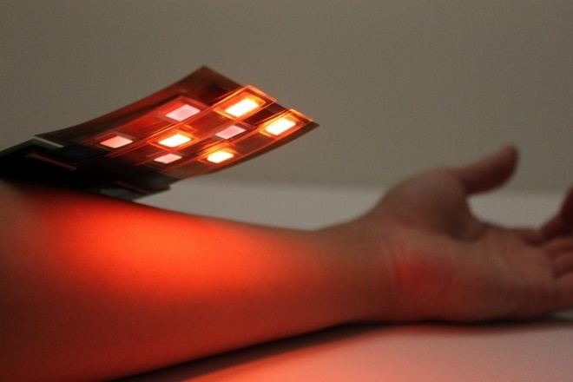
ECE 105: Introduction to Electrical Engineering
Lecture 14
Bio sensing 4
Yasser Khan
Rehan Kapadia

Slide 2
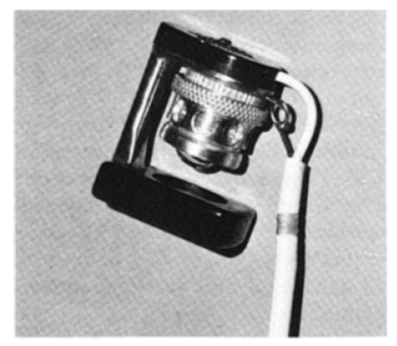
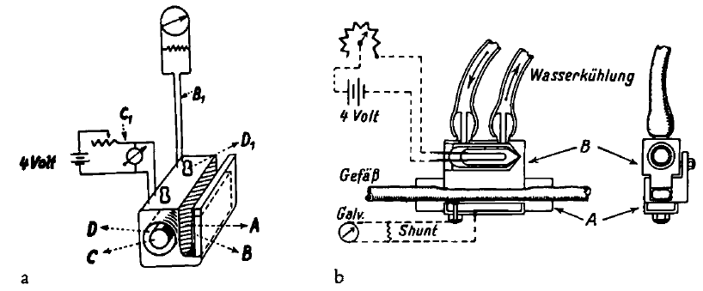
Oximetry - History
1864, The discovery that the colored substance in blood was the carrier of oxygen was made by George Gabriel Stokes (1819-1903)
1935, Kurt Kramer (1906-1985) showed that the Lambert-Beer law applied to hemoglobin solutions and approximately to whole blood, and measured saturation by the transmission of red light through unopened arteries.
1942, Glenn Allan Millikan (1906-1947) built a light-weight ear "oximeter“ during World War II to train pilots for military aviation using a mercury vapor light, yellow and purple filters, and a copper oxide photocell.
1935
1942
1864

Slide 3
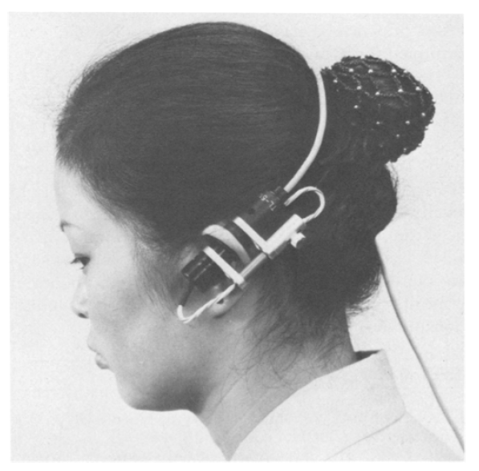
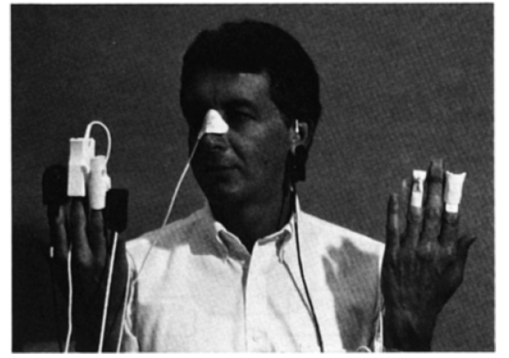
Oximetry - History
Around 1964, Robert Shaw, a surgeon and inventor in San Francisco, began design and construction of a self-calibrating, eight-wavelength ear oximeter. His concept was to uniquely solve the simultaneous equations by using one more wavelength than the number of separate forms of hemoglobin needing identification.
1975, Pulse oximetry was reported by Nakajima, Hirai, Takase, Kuse, Aoyagi, Kishi, and Yamaguchi of the Minoha Corporation. They used fiberoptic bundles to conduct light to and from a finger. Initially the main problem was extreme sensitivity to motion.
Solid state pulse oximeter "probes" on typical locations. Ohmeda Company, Boulder, CO.
1935
1942
1975
1864
1964

Slide 4
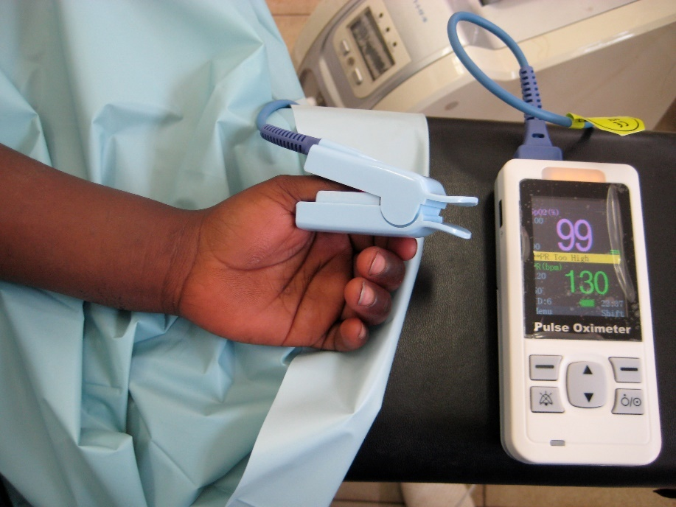
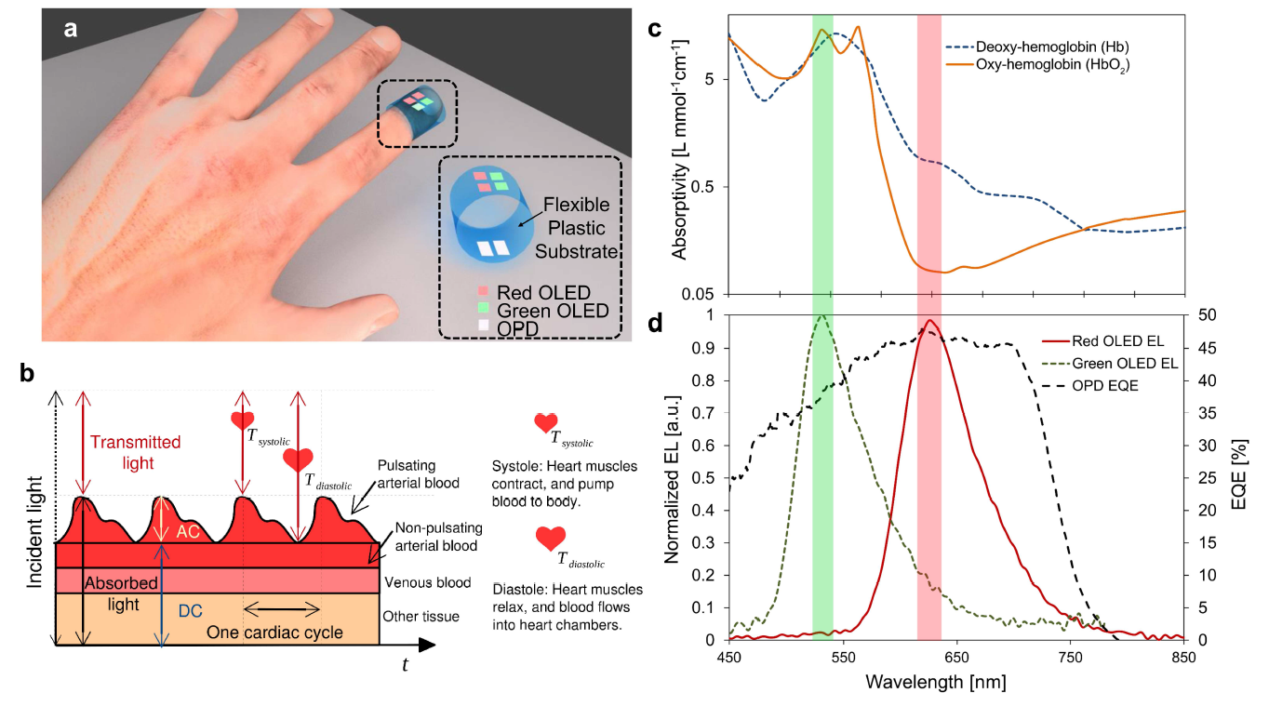
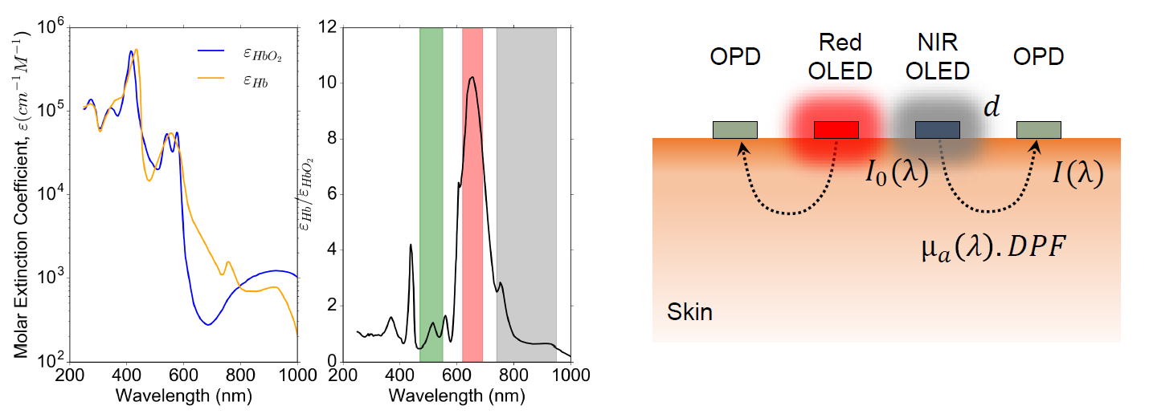

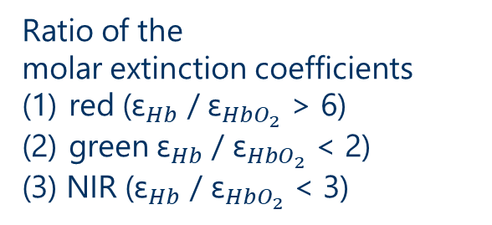


Motivation for flexible oximeters
Flexible and printed oximeter sensor to replace conventional rigid finger probe.
The difference in the molar extinction coefficient of oxygenated and deoxygenated hemoglobin at green is comparable to the difference at NIR wavelengths.
Either of the combinations of “red and green” or “red and NIR” can be used for oximetry.
(2)
(1)
(3)
Ratio of the
molar extinction coefficients
red (${\text{ε}}_{Hb}$ / ${\text{ε}}_{HbO_{2}}$ > 6)
green ${\text{ε}}_{Hb}$ / ${\text{ε}}_{HbO_{2}}$ < 2)
(3) NIR (${\text{ε}}_{Hb}$ / ${\text{ε}}_{HbO_{2}}$ < 3)

Slide 5
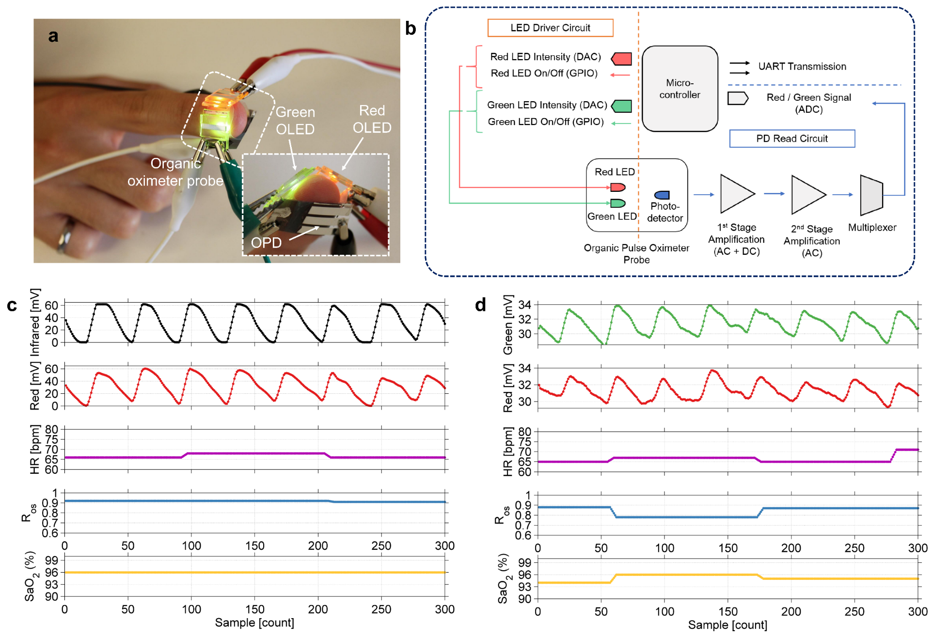
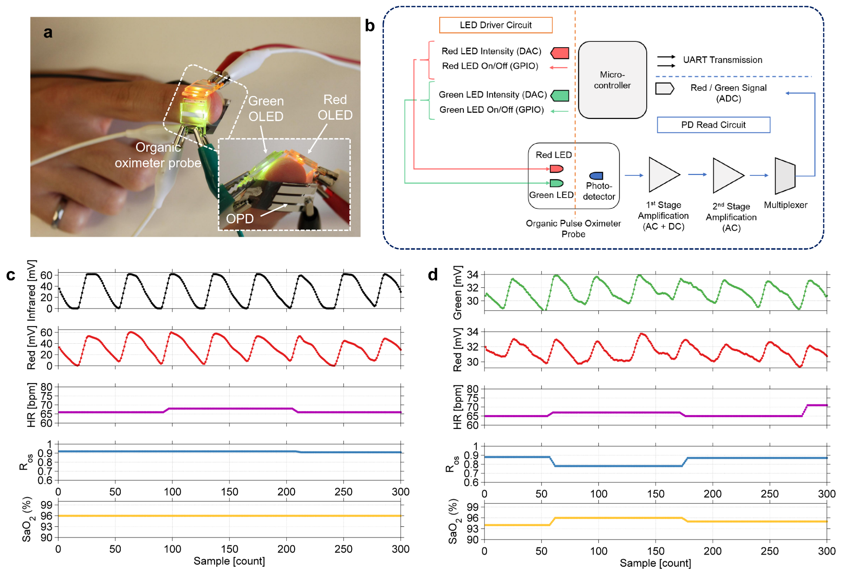
Organic optoelectronic pulse oximetry system
The PPG signal obtained using red and infrared light of commercially available probe
The PPG signal obtained using red and green light of the organic probe
Oximeter probe
Heart rate (HR) was obtained by timing the systolic peaks in the PPG signals.
The ratio of the transmitted light at two wavelengths (Ros) is converted to arterial blood oxygen saturation (SaO2) using Beer-Lambert’s Law in conjunction with an empirical correction.
The organic sensor accurately measures pulse rate and oxygenation with errors of 1% and 2%, respectively.

Slide 6
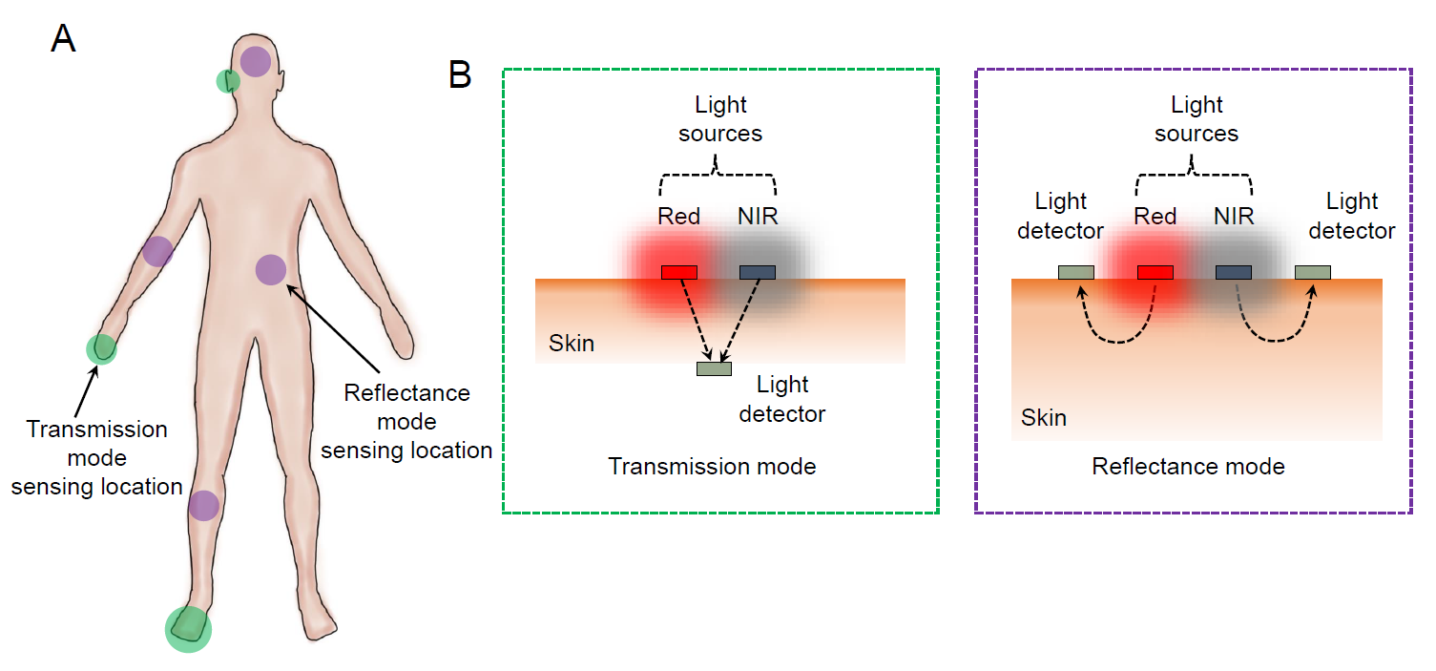
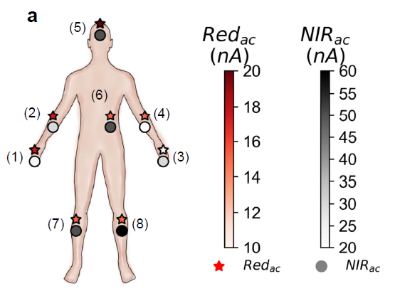
Transmission vs. reflectance oximetry
Transmission-mode pulse oximetry is limited only to tissues that can be transilluminated, such as the earlobes and the fingers.
If reflected light is used as the signal, the sensor can be used beyond the conventional sensing locations.
AC signal is the highest at the forehead for both Red and NIR channels.
Arms provide mid-range AC amplitude, while signal strength is low in the legs and chest area.
Forehead is the best location for reflectance pulse oximetry.

Slide 7
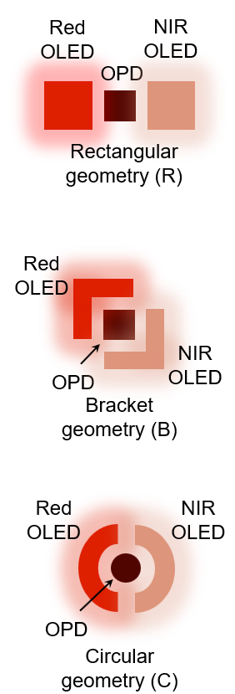
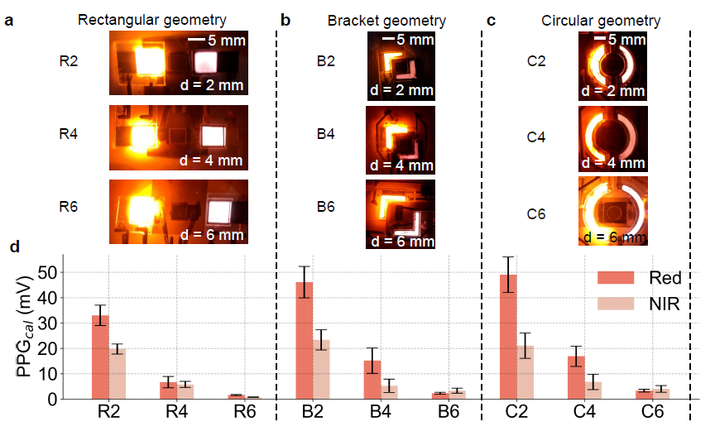


Effect of different sensor geometries
Convention geometry
Non-convention geometry
Non-convention geometry
Use perimeter lighting to increase the incident light.
Use large-area light sources to improve PPG signal magnitude by spreading the flux over an area, rather than a single spot.
Due to perimeter lighting and better light collection by the OPD, both bracket and circular geometries outperform the rectangular design in both pulsatile PPG signal magnitude and sensor efficiency.
The bracket and circular design provide a negligible difference of PPG_{ac}.

Slide 8
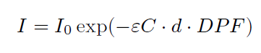
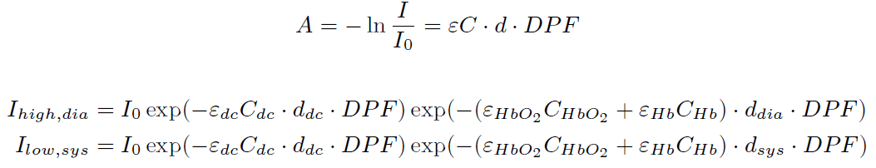
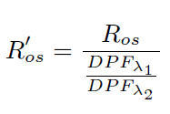
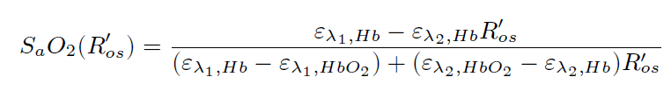
Reflectance pulse oximetry
Here, I₀ is the incident light intensity,
ε is the molar extinction coefficient with unit of mM⁻¹cm⁻¹,
C is the concentration of the absorbent substance, and
d is the optical path length through the medium.
The absorbance, A, is now defined as,
Skin, tissue, and bones
Oxy-hemoglobin
Deoxy-hemoglobin
Oxygen Saturation,
Ratio,

Slide 9
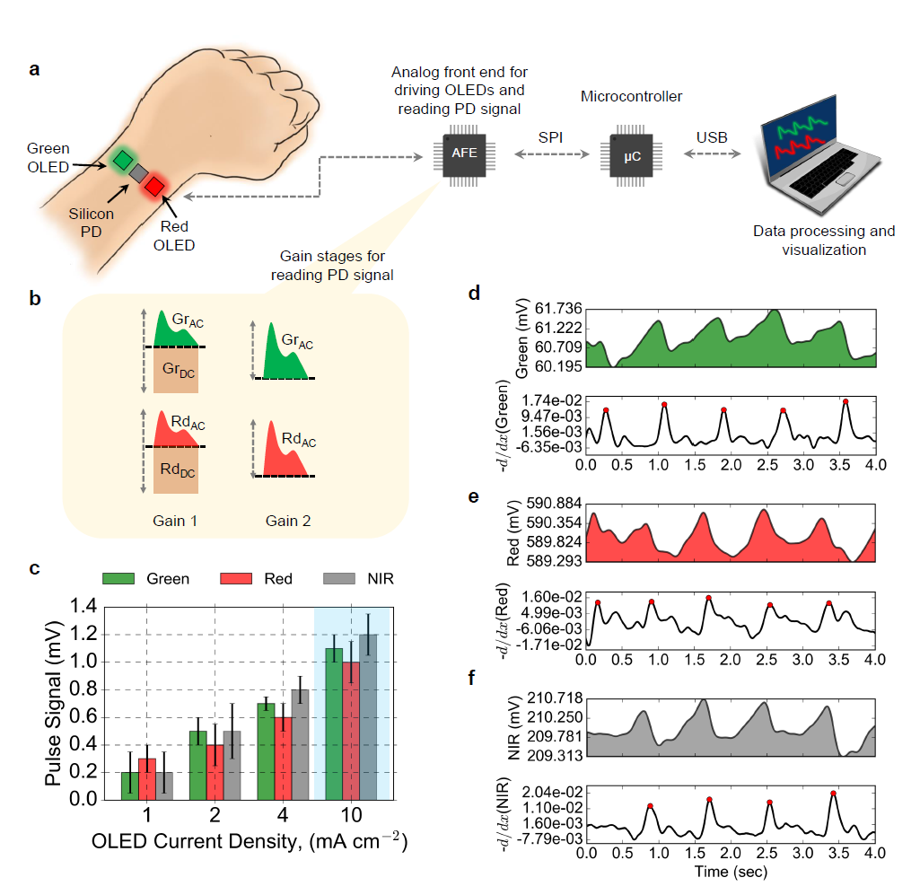
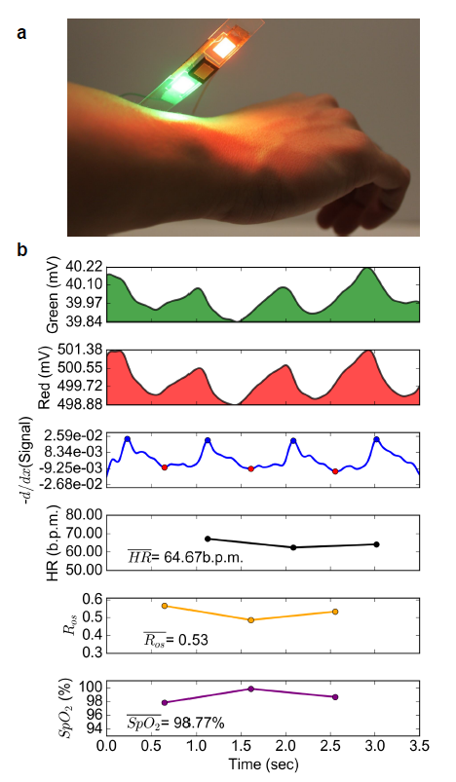
Reflection-mode PPG
Light absorption in the tissue depends on the wavelength of the light and, as a result, PPG signal attenuation of visible light is much more pronounced than that of NIR light.

Slide 10
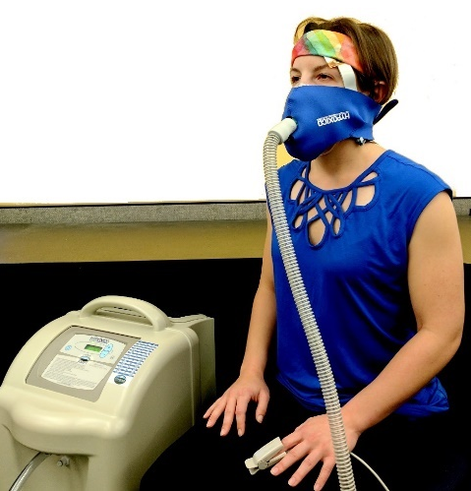
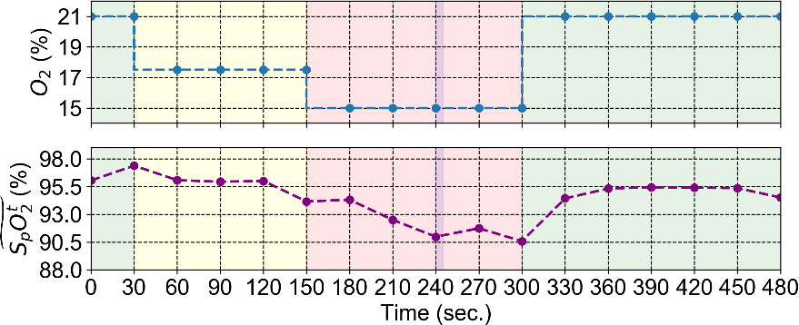
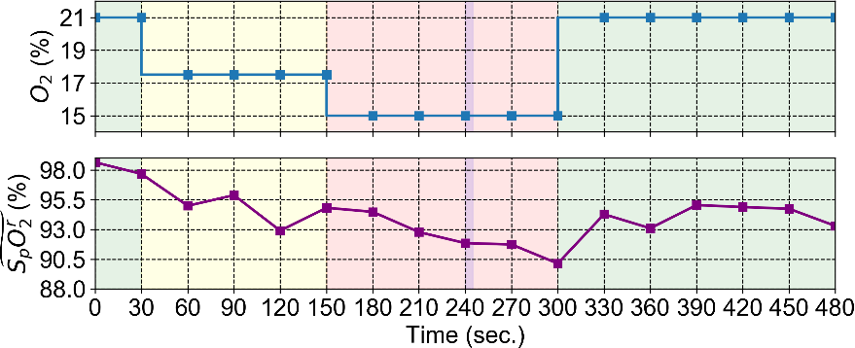
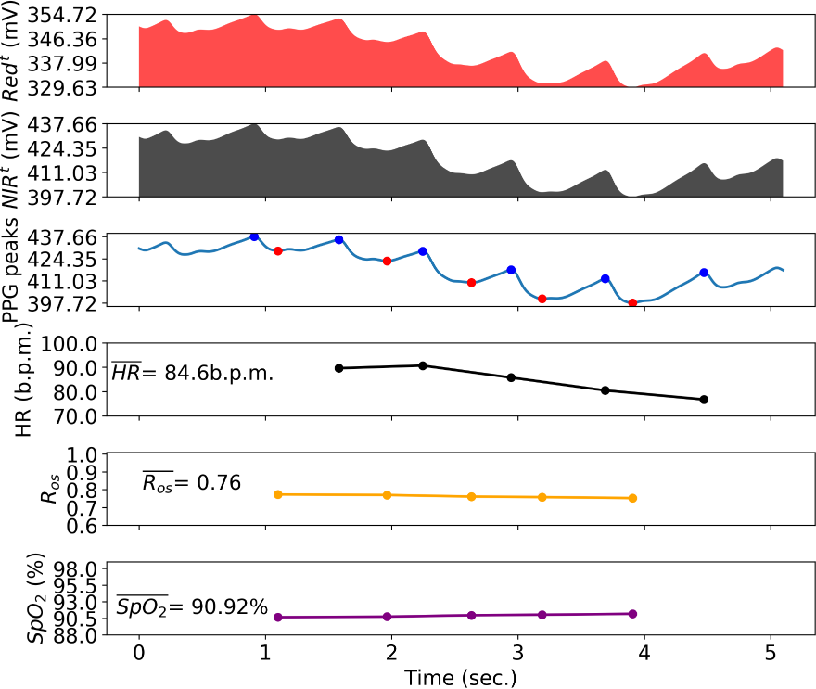
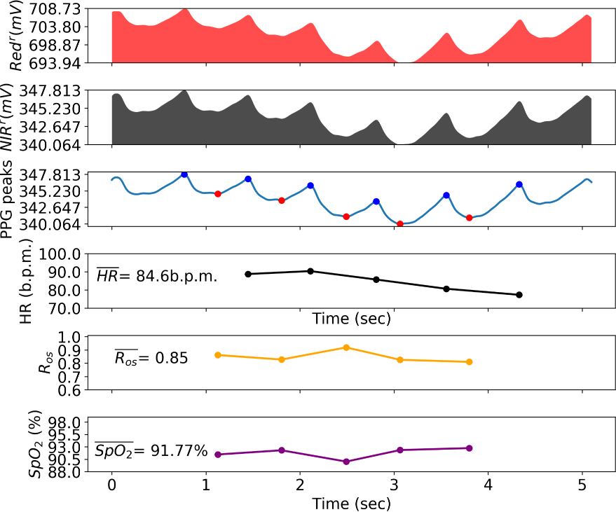
Reflectance probe
Simultaneous transmission and
reflection oximetry
Facemask
Oxygen intake of a volunteer was controlled using an altitude generator. Both transmission and reflection-mode data was collected using a commercial and the printed probe, respectively.
Altitude generator
Finger probe
The reflectance oximeter measures SpO2 on the forehead with 1.1 % mean error compared to commercial transmission-mode pulse oximeters, which falls within the 1-2 % error margin that is inherent to pulse oximetry.
Commercial finger probe – transmission
Reflectance probe – forehead

Slide 11
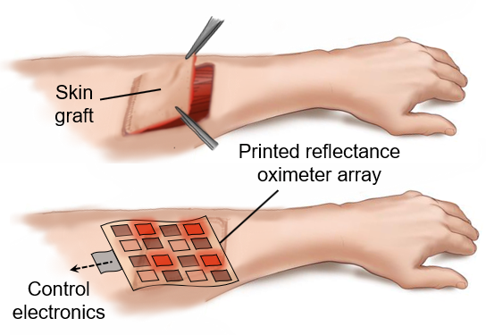
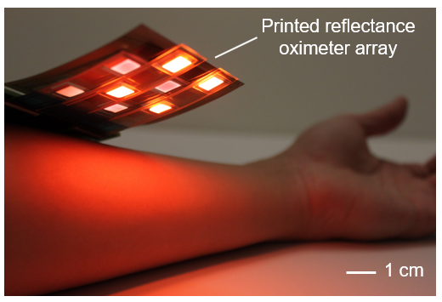
Printed oximeter array
Surgeons use skin flaps and grafts to reconstruct damaged skin.
If blood supply to the flap or graft is compromised an oxygenation mapping device can be used to detect the insufficient oxygen supply.
An array of oximeters provide 2D oxygenation mapping capability, and is promising for mapping oxygenation in tissues, wounds, pressure ulcers, or transplanted organs.

Slide 12
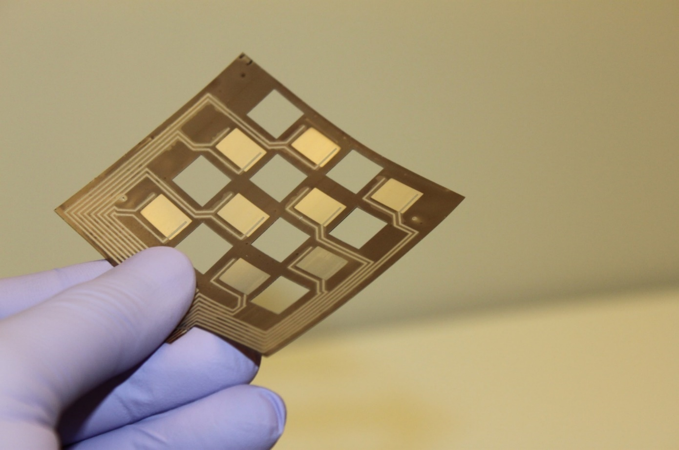
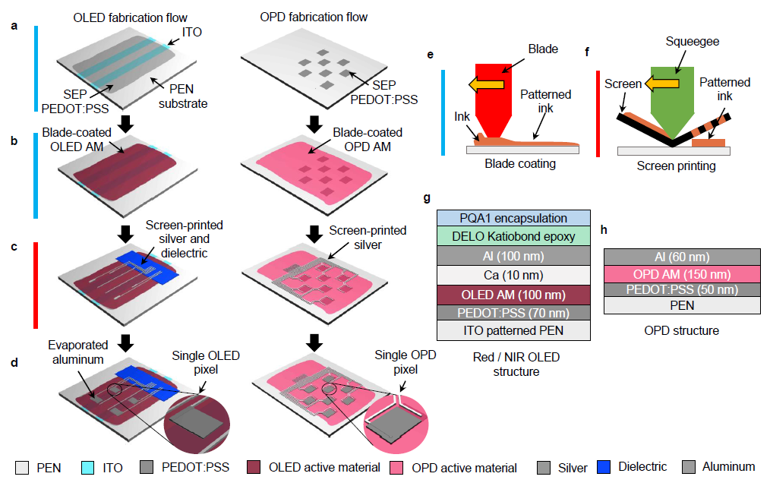
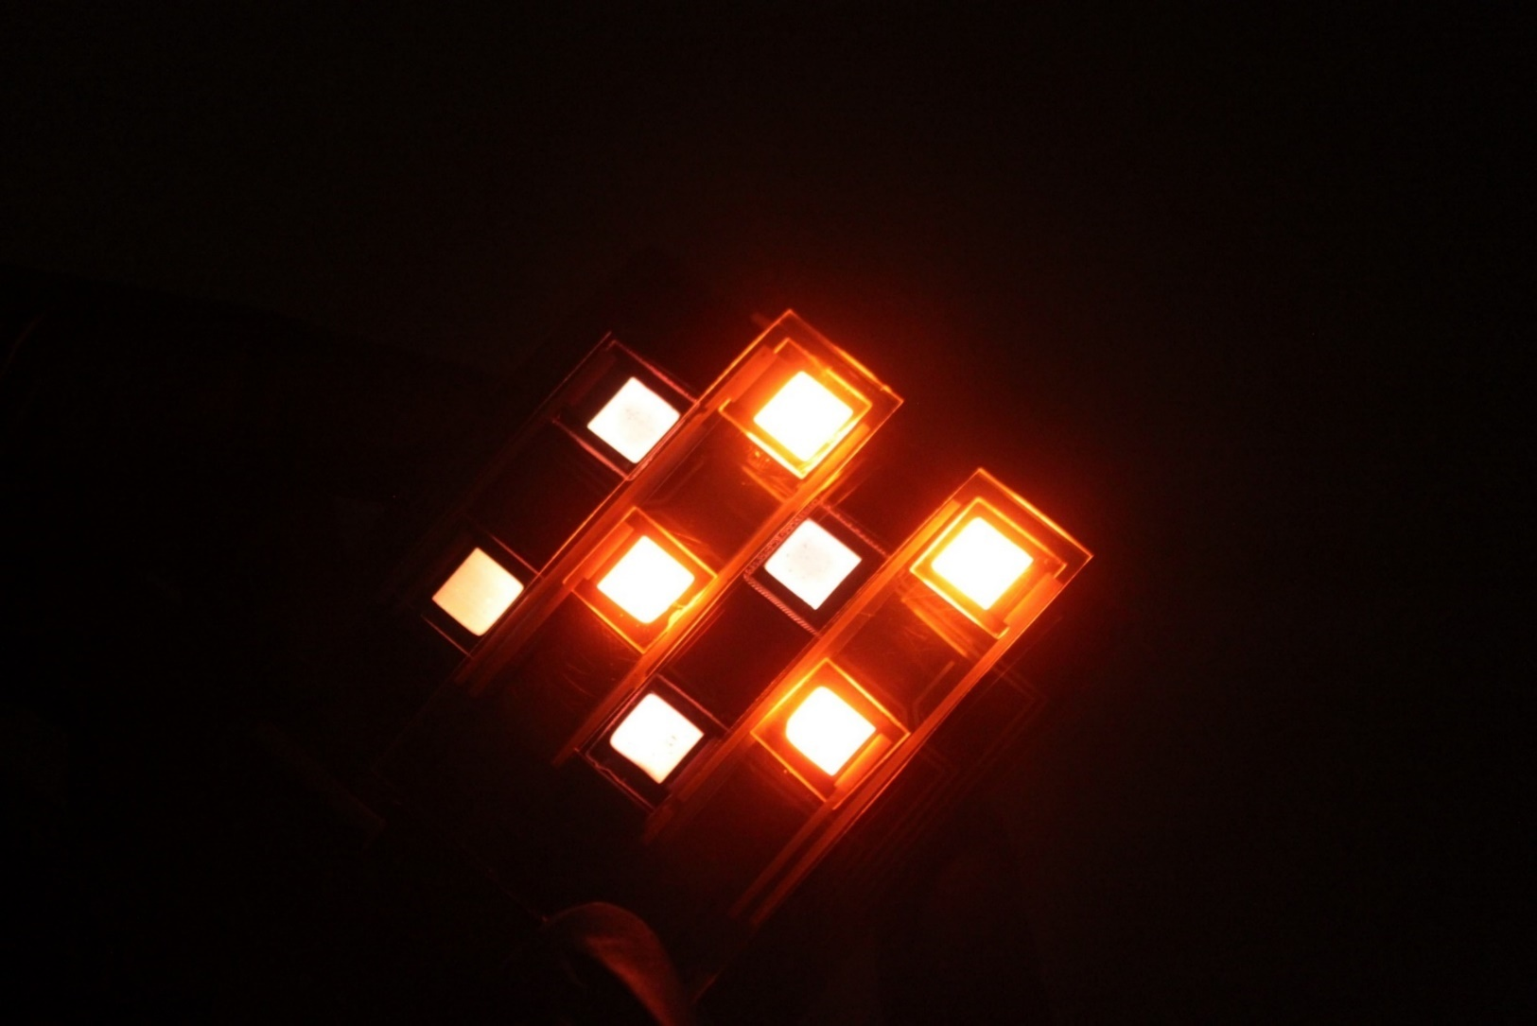
Oximeter array fabrication
OPD array
A series of surface energy pattering, blade coating, and screen printing steps are utilized to fabricate the array.
Red and NIR OLED array

Slide 13
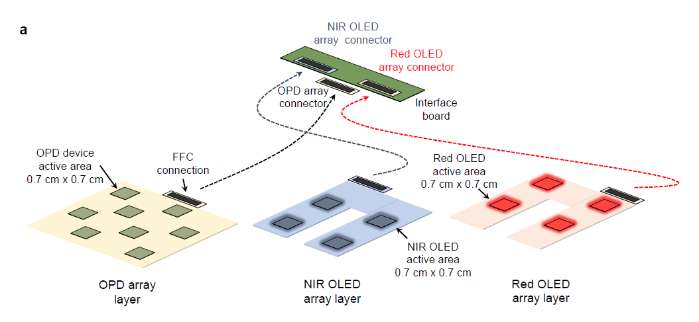
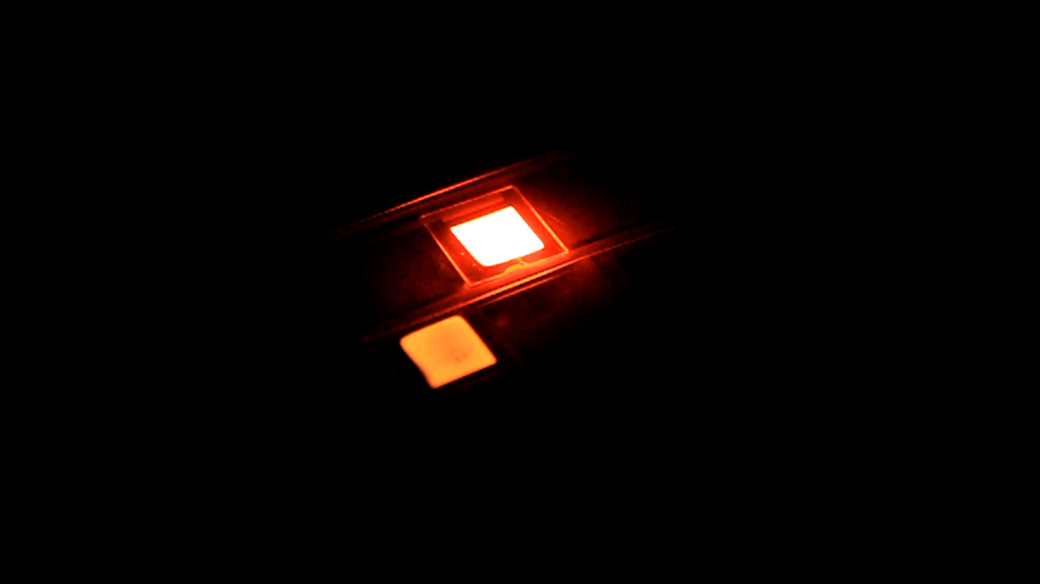
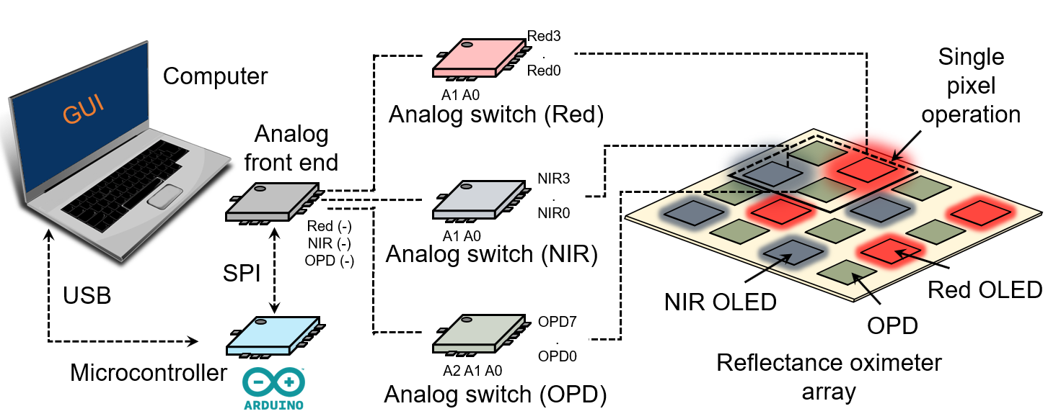
Printed Oximeter Array
OLED array – switching pixels
Each pixel of the array (one red and one NIR OLED, and two OPDs) is connected to an analog front end (AFE) using multiplexers (MUXs), for both single pixel and array operation using the control electronics. The AFE drives the OLEDs and reads out the OPD signal.

Slide 14
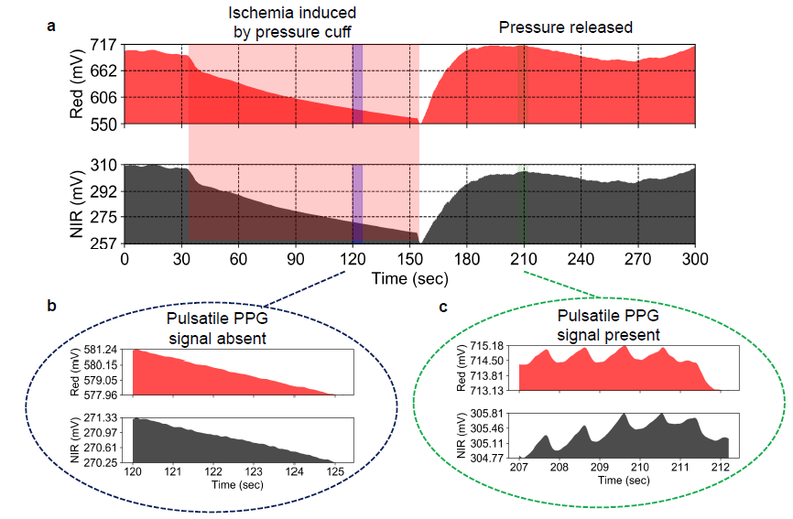

Oximetry under pressure cuff induced ischemia
Due to low perfusion,
or places on the body that have a low pulsatile signal,
or to monitor oxygenation for tissue damage and injury
susceptibility, a modified oximetry model is required.
Pulsatile signal present – pulse oximetry viable
Pulsatile signal absent – pulse oximetry not viable

Slide 15
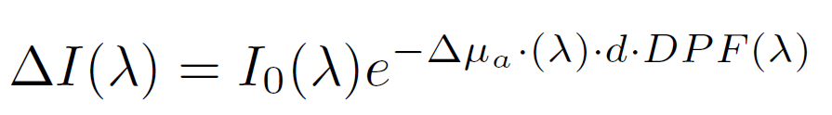
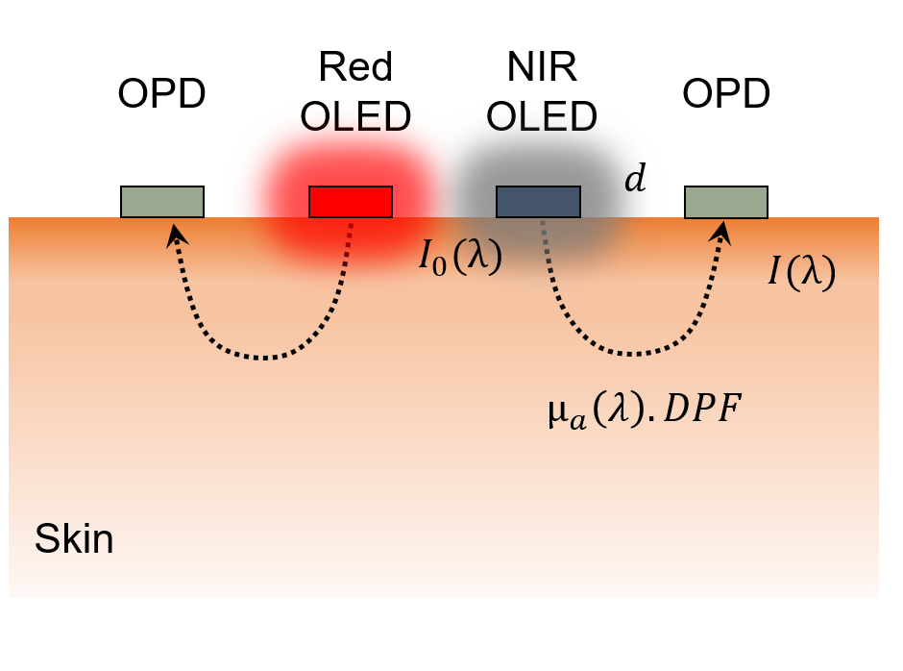
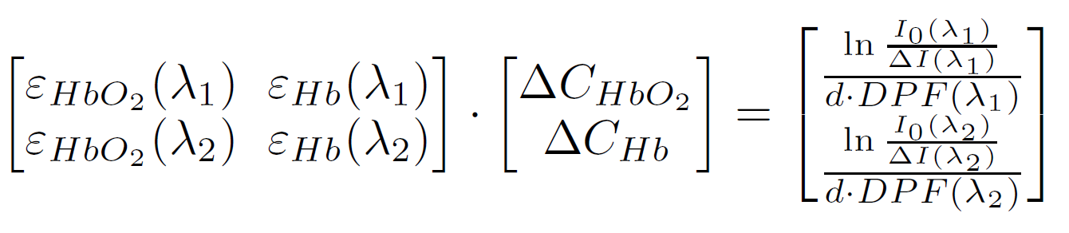
Reflection oximetry in the absence of pulsatile signal
Where I(λ) is the measured diffuse reflected light intensity, I0 (λ) is the incident light intensity, μa(λ) is the absorption coefficient of the probed tissue, d is the distance between the positions of incident and measured light, i.e., the source–detector separation, DPF(λ) the differential pathlength factor (DPF).
μa (λ) is given as the sum of the specific absorption coefficients α (λ), of HbO2 and Hb, times the concentration.
Change in concentration of HbO2 and Hb can be used to calculate the change in SO2.

Slide 16
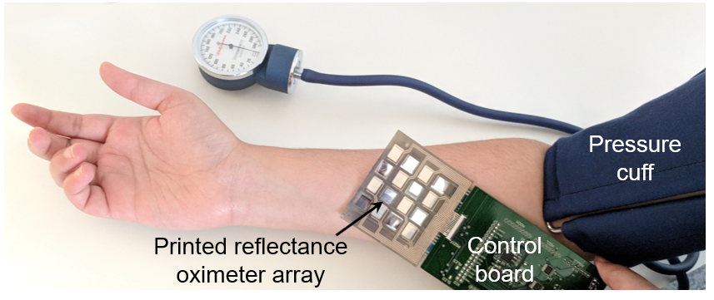
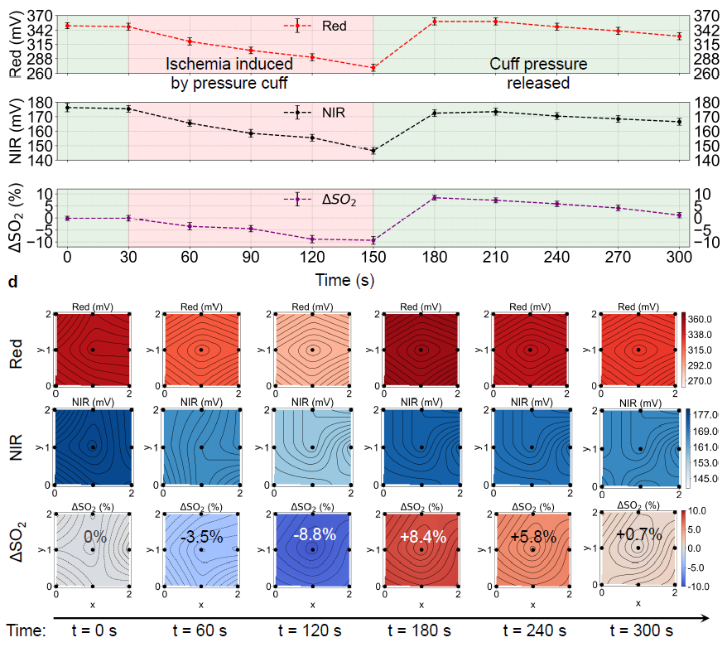
2D oxygen saturation monitoring in-vivo
Blood supply to the forearm is controlled by a pressure cuff.
ΔSO2 varies from 0 % under normal condition to - 9 % under ischemia, and rises to 10 % when the pressure is released.

Slide 17
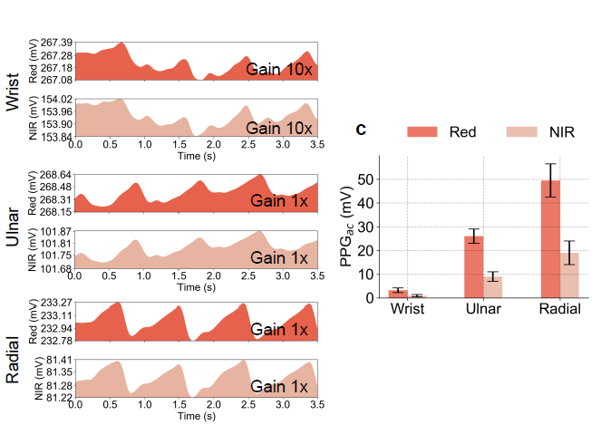
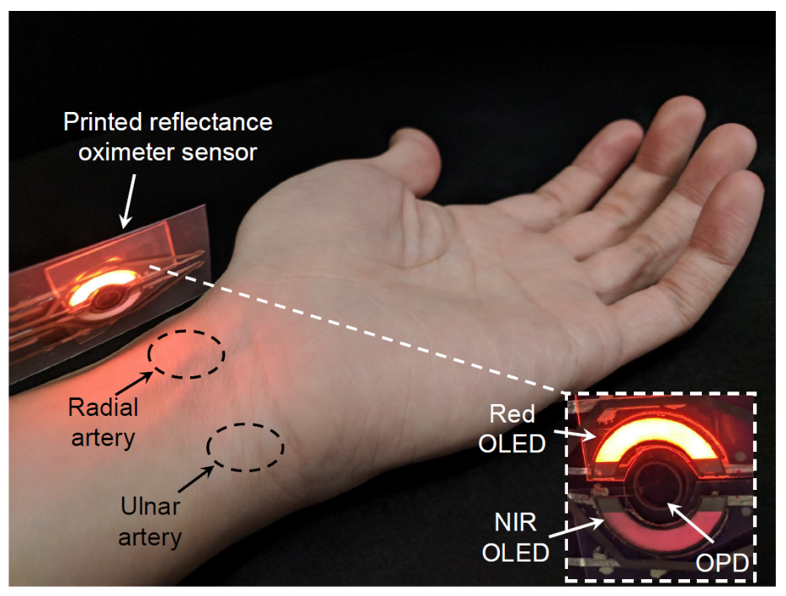
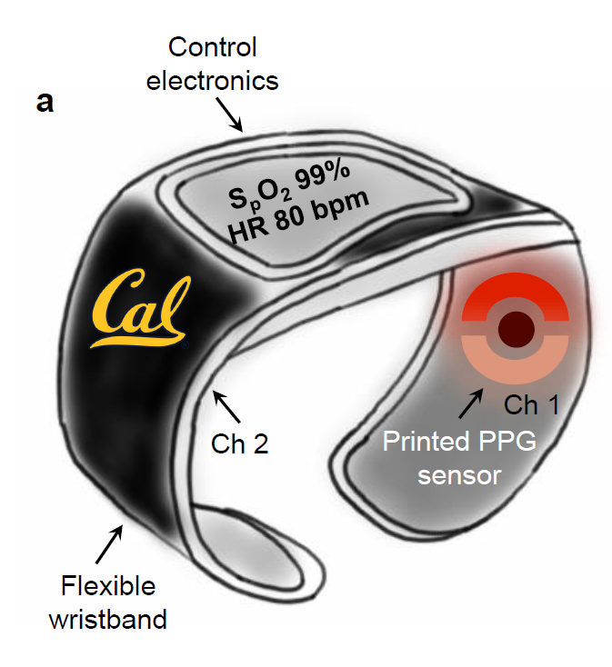
Organic smart wristbands
The PPG signal on the underside of the wrist is much stronger.
The watch band is used as a sensor.
Multiple PPG channels are used to add redundancy to the measurement.
Intelligent channel selection and use of a weighting algorithm increase accuracy to the data.

Slide 18
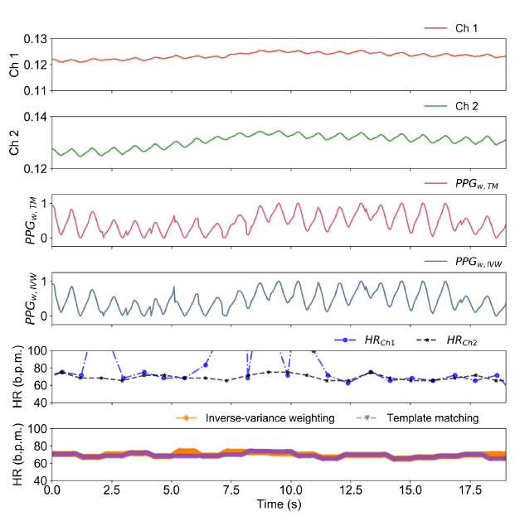
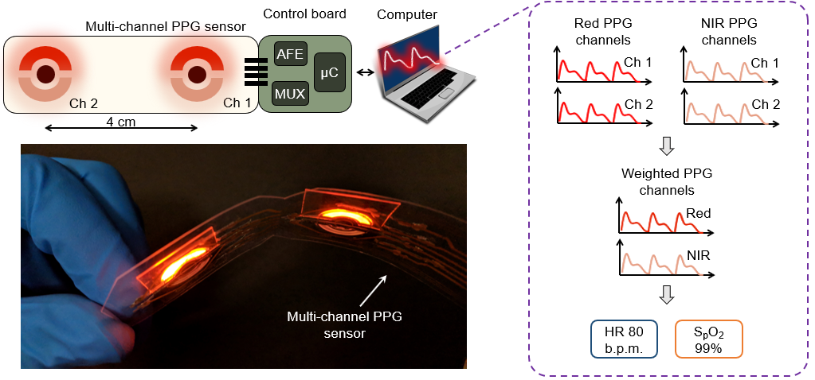
Smart wristband with intelligent channel selection
The sensor is placed on the underside of the wrist, where Ch 1 collects data from the ulnar artery and Ch 2 collects data from the radial artery.
After implementing template matching and inverse-variance weighting algorithms, accurate detection of HR is observed for both the algorithms compared to using only using Ch 1.

Slide 19
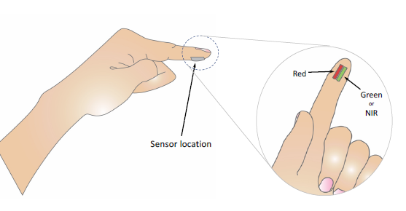
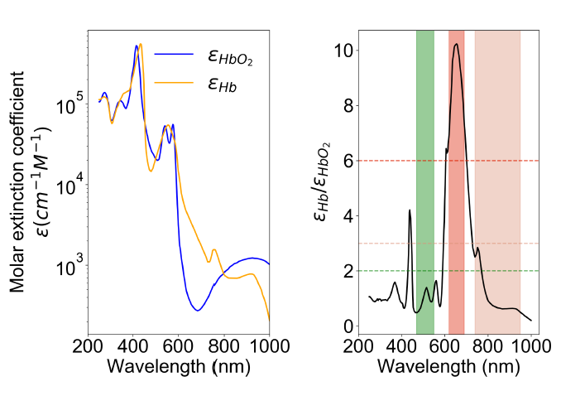
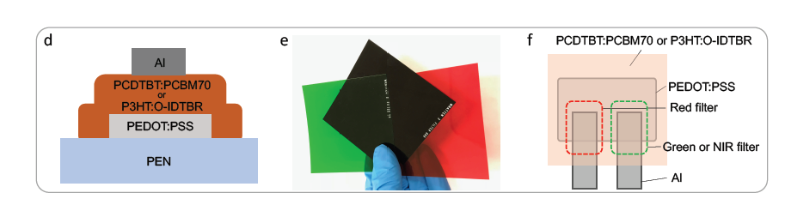
Ambient light sources for oximetry
Use ambient light as the light source for pulse oximetry.
Develop photodiodes that are sensitive at green, red, and near-infrared light.
Significantly reduce power consumptions of pulse oximeters.

Slide 20
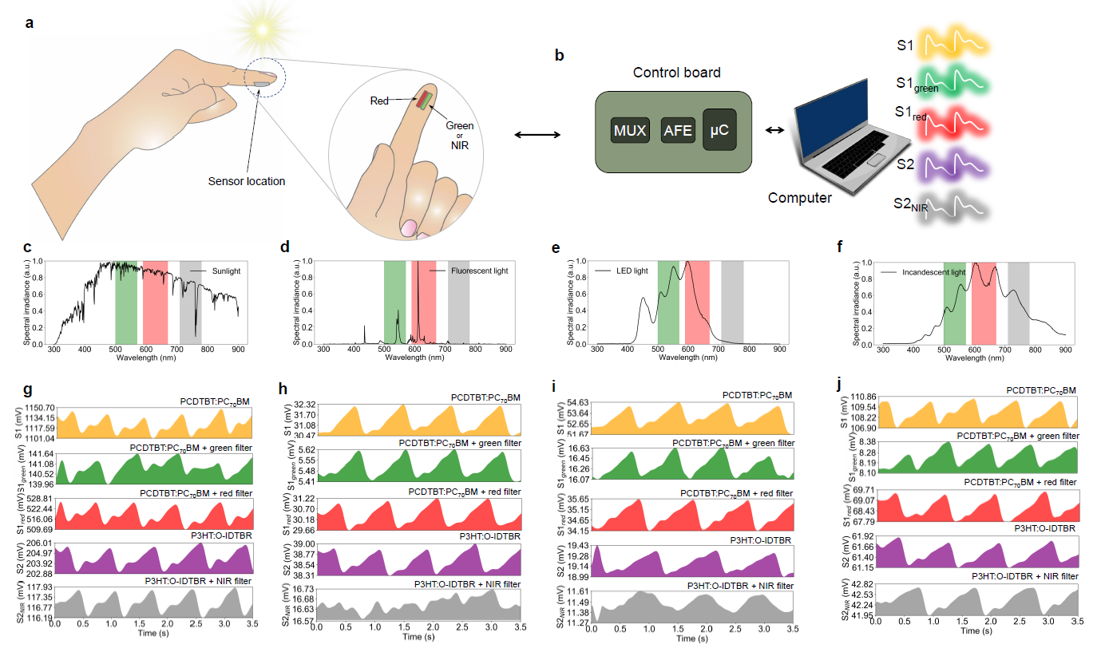

PPG with various ambient light sources
Green, red, and NIR light sensors are designed with OPDs and filters
Most ambient light sources include red and green light combinations for oximetry
Sunlight and incandescent light has both red + green and red + NIR combinations for oximetry
Sunlight
Fluorescent
LED
Incandescent

Slide 21



Sun as the light source for oximetry
Pulse oximetry can be done using sunlight with red + green and red + NIR light combinations
Results are validated with commercial oximeters, and by varying oxygenation levels
Lowest power oximeter!

Slide 22




Flexible oximeters over the years
Red and green OLEDs interfaced with OPD for transmission-mode oximetry, Nat. Commun. 2014 - Berkeley
Ultraflexible organic photonic skin, Sci. Adv. 2016 – U of Tokyo
Thin, Battery-free, Skin-like Devices for Blood Oximetry, Sci. Adv. 2016 – Illinois
Printed flexible PLEDs interfaced for reflectance-mode oximetry, Adv. Mater. 2017 - Berkeley
Printed PLED and OPD arrays for reflectance-mode oximetry, PNAS 2018 - Berkeley

Slide 23





Challenge project – what’s what
data-1.csv, data-2.csv, and data-3.csv are taken with red, blue, and no filters. You will have to detect which data uses which filter with code written in the python notebook.
Rules
Teams of two students.
Raise your arm when your code is ready to identify the data files automatically.
You’ll get one chance for giving the correct answer.
You’ll have to explain why the signals are different in different data files.

